Slide 1
L3d5
Cu boulder
Csci 3155: principles of programming languages
Summer 2018
Spencer wilson
06/25/2018

Slide 2
Brain Teaser
Suggest operations I might want to perform on the language defined by the following grammar :
S ::= a | b S c | T c S c S
T ::= ϵ | a T

Slide 3
Midterm
Tomorrow in class 75 minute exam.
Counts as the in class exercise for tomorrow
There is no Moodle quiz or reading for tomorrow
Accommodations – see piazza

Slide 4
In class exercise
I have taken a mental snap-shot of who is present and if you stay for the whole class you will receive full credit for this assignment.

Slide 5
Brain Teaser
Suggest operations I might want to perform on the language defined by the following grammar :
S ::= a | b S c | T c S c S
T ::= ϵ | a T

Slide 6
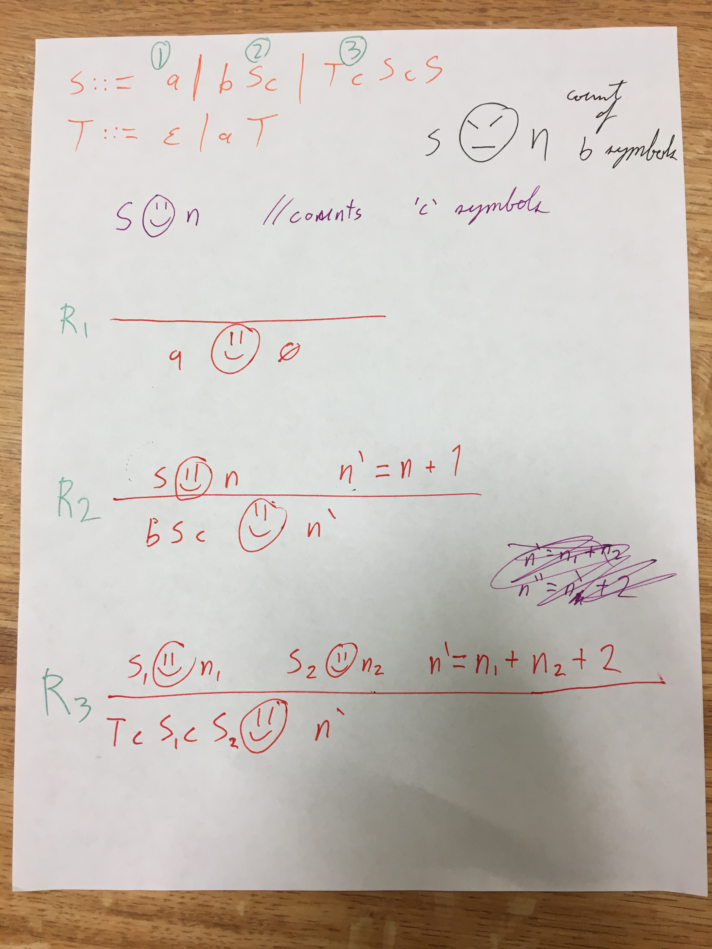
Using the smileyFace
Operational semantic
To find the number of
`c` symbols in a sentence

Slide 7
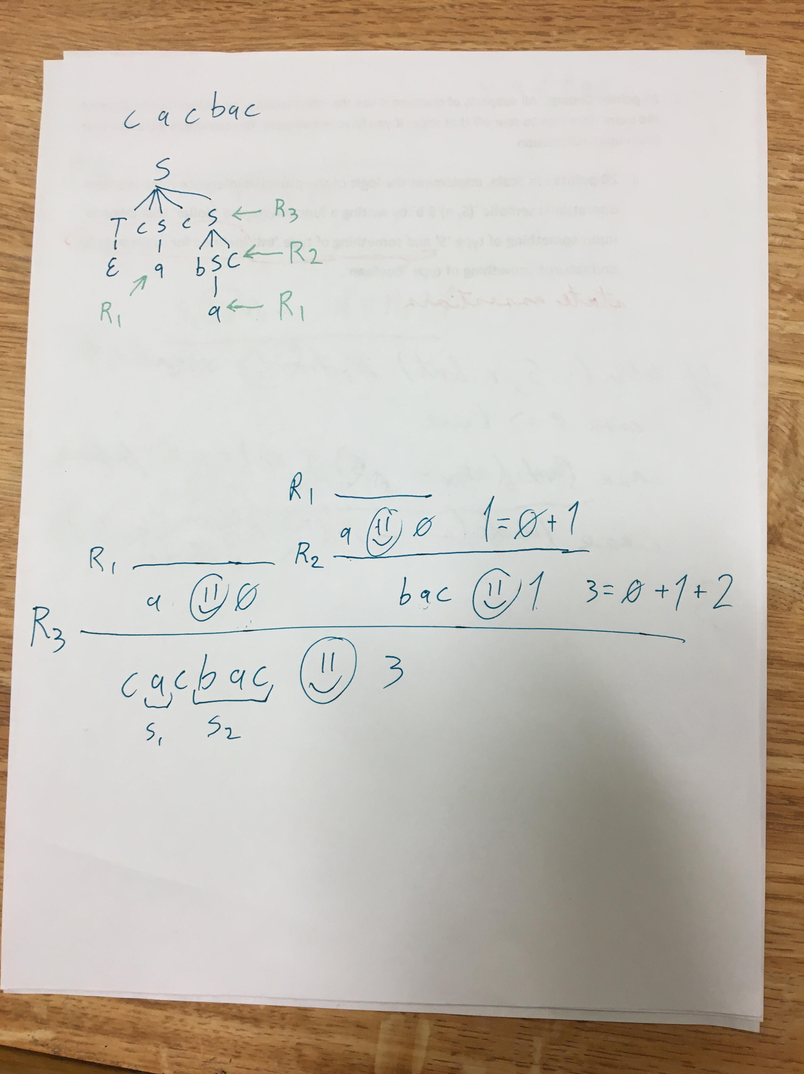
<<< This parse tree might
Help connect ideas
Writing a derivation
Using the rules
VVV

Slide 8
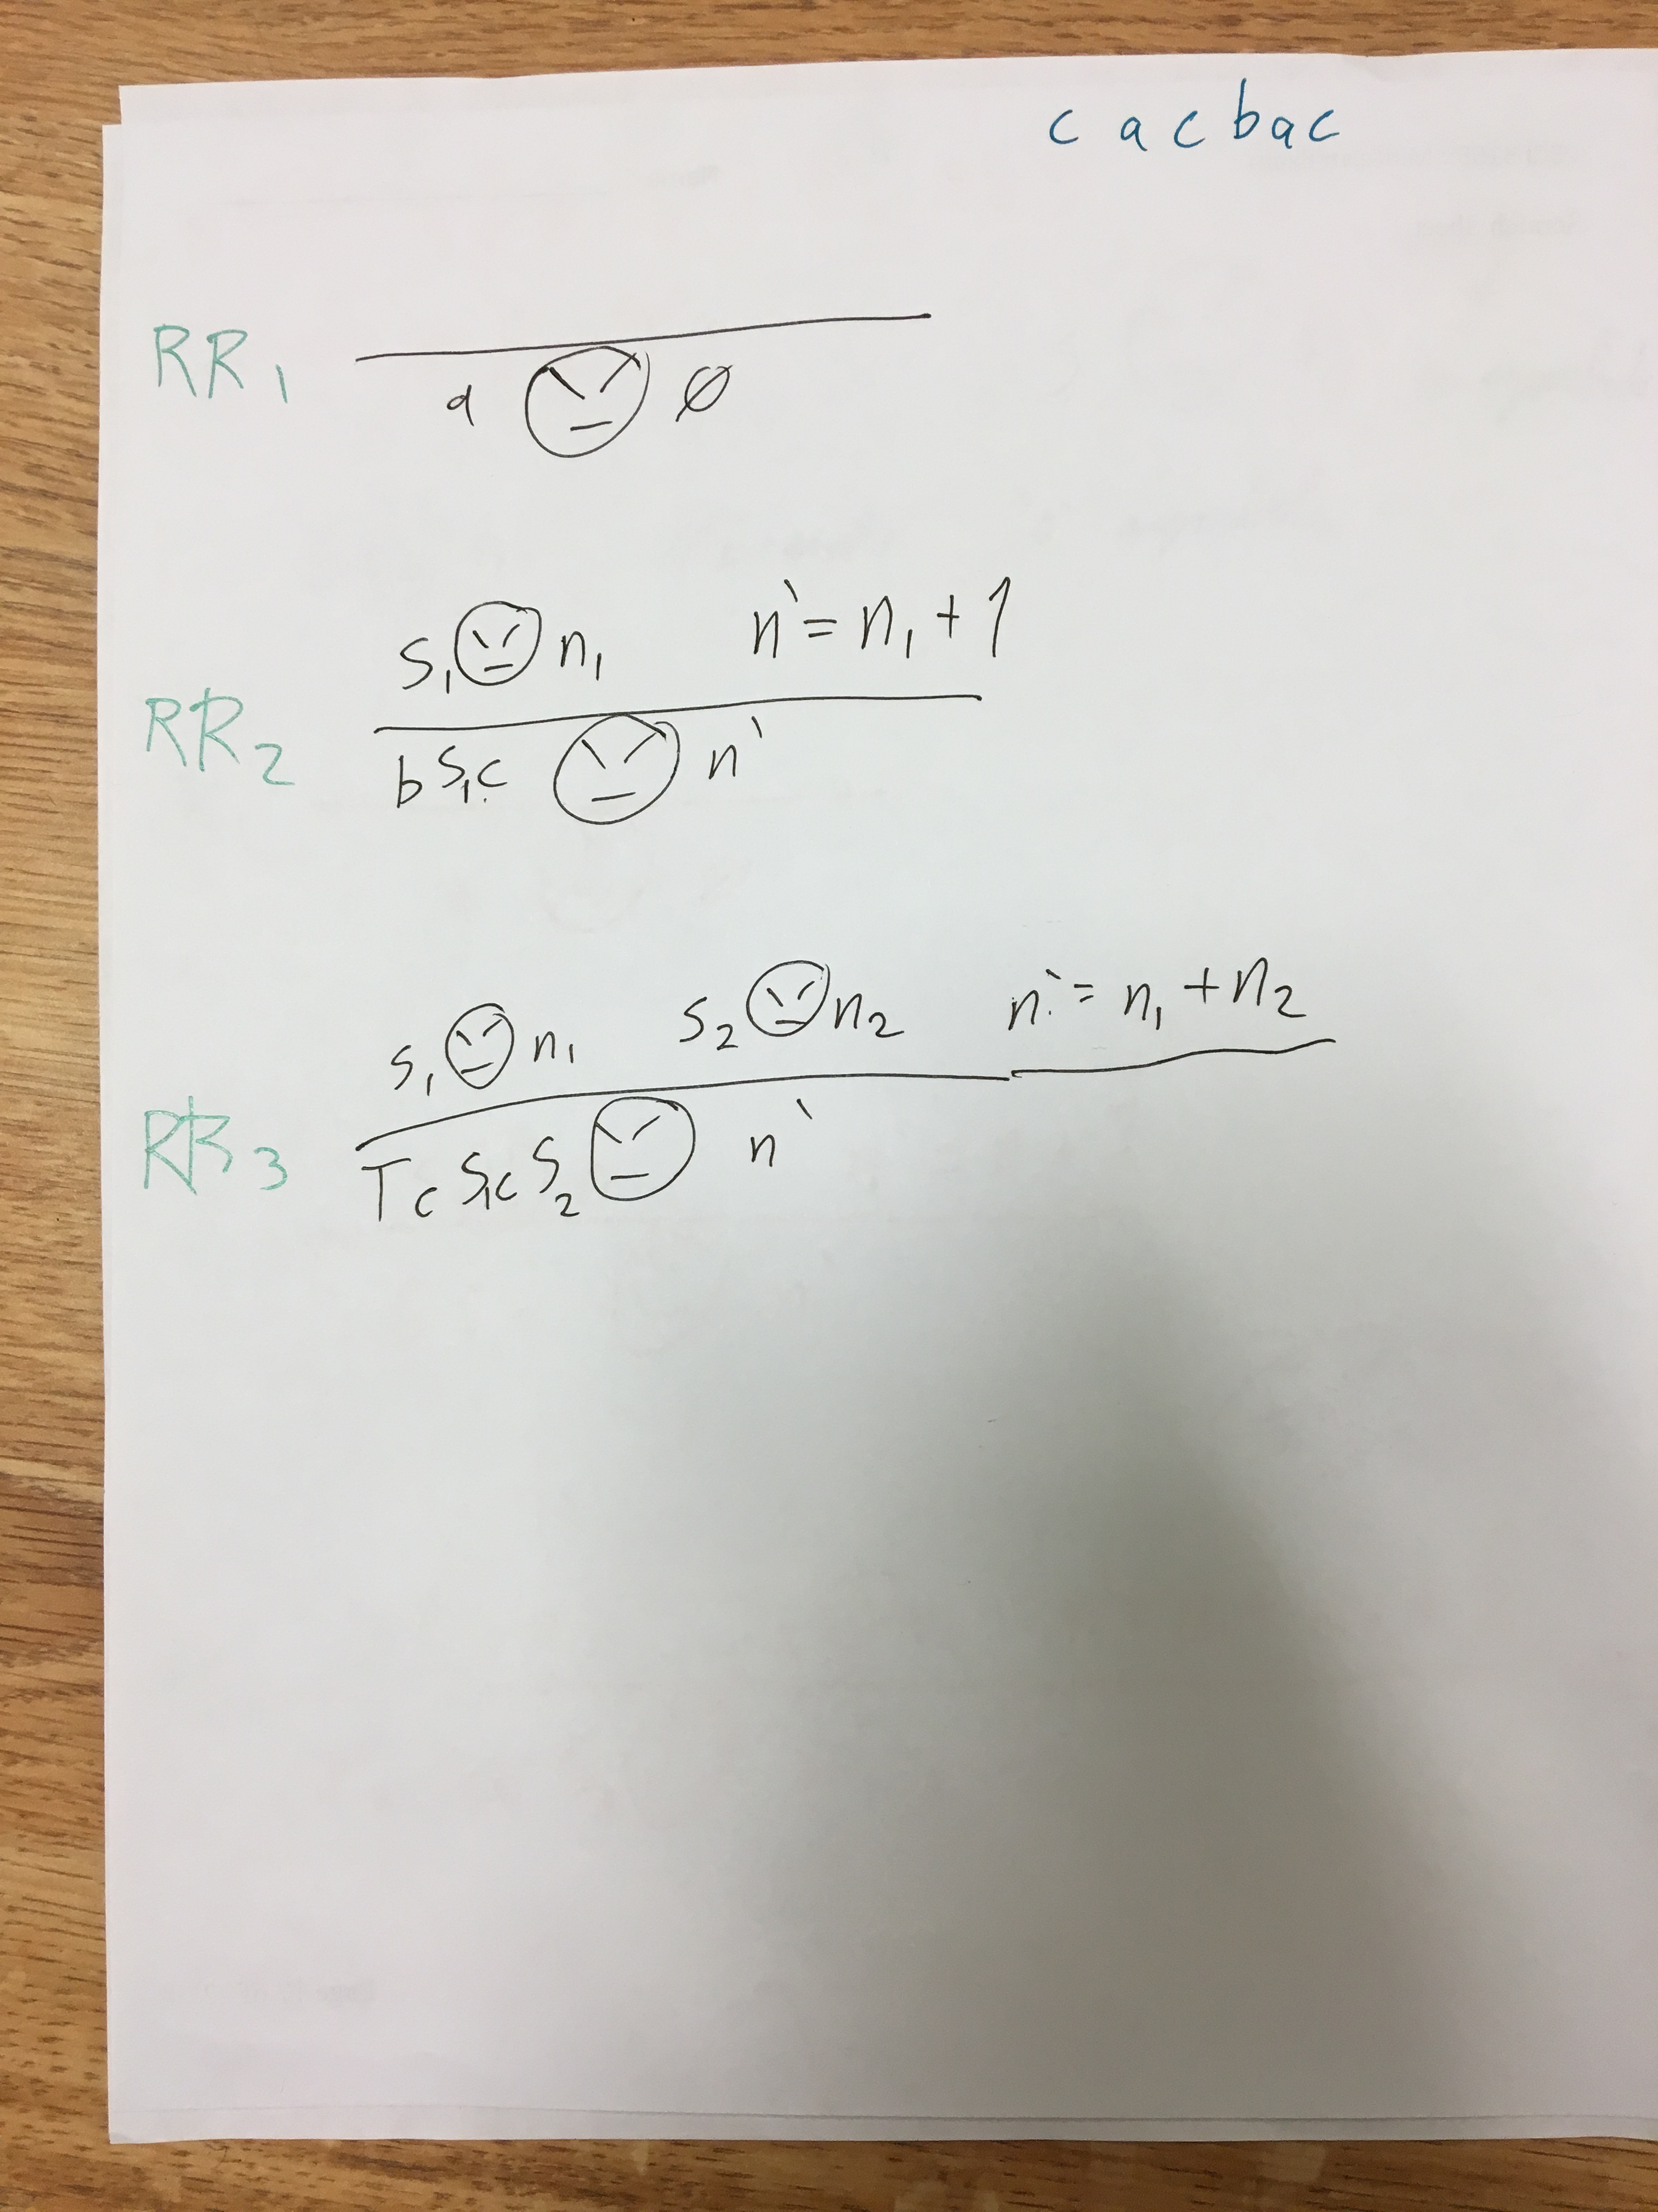
Rules to count the number
Of `b` symbols

Slide 9
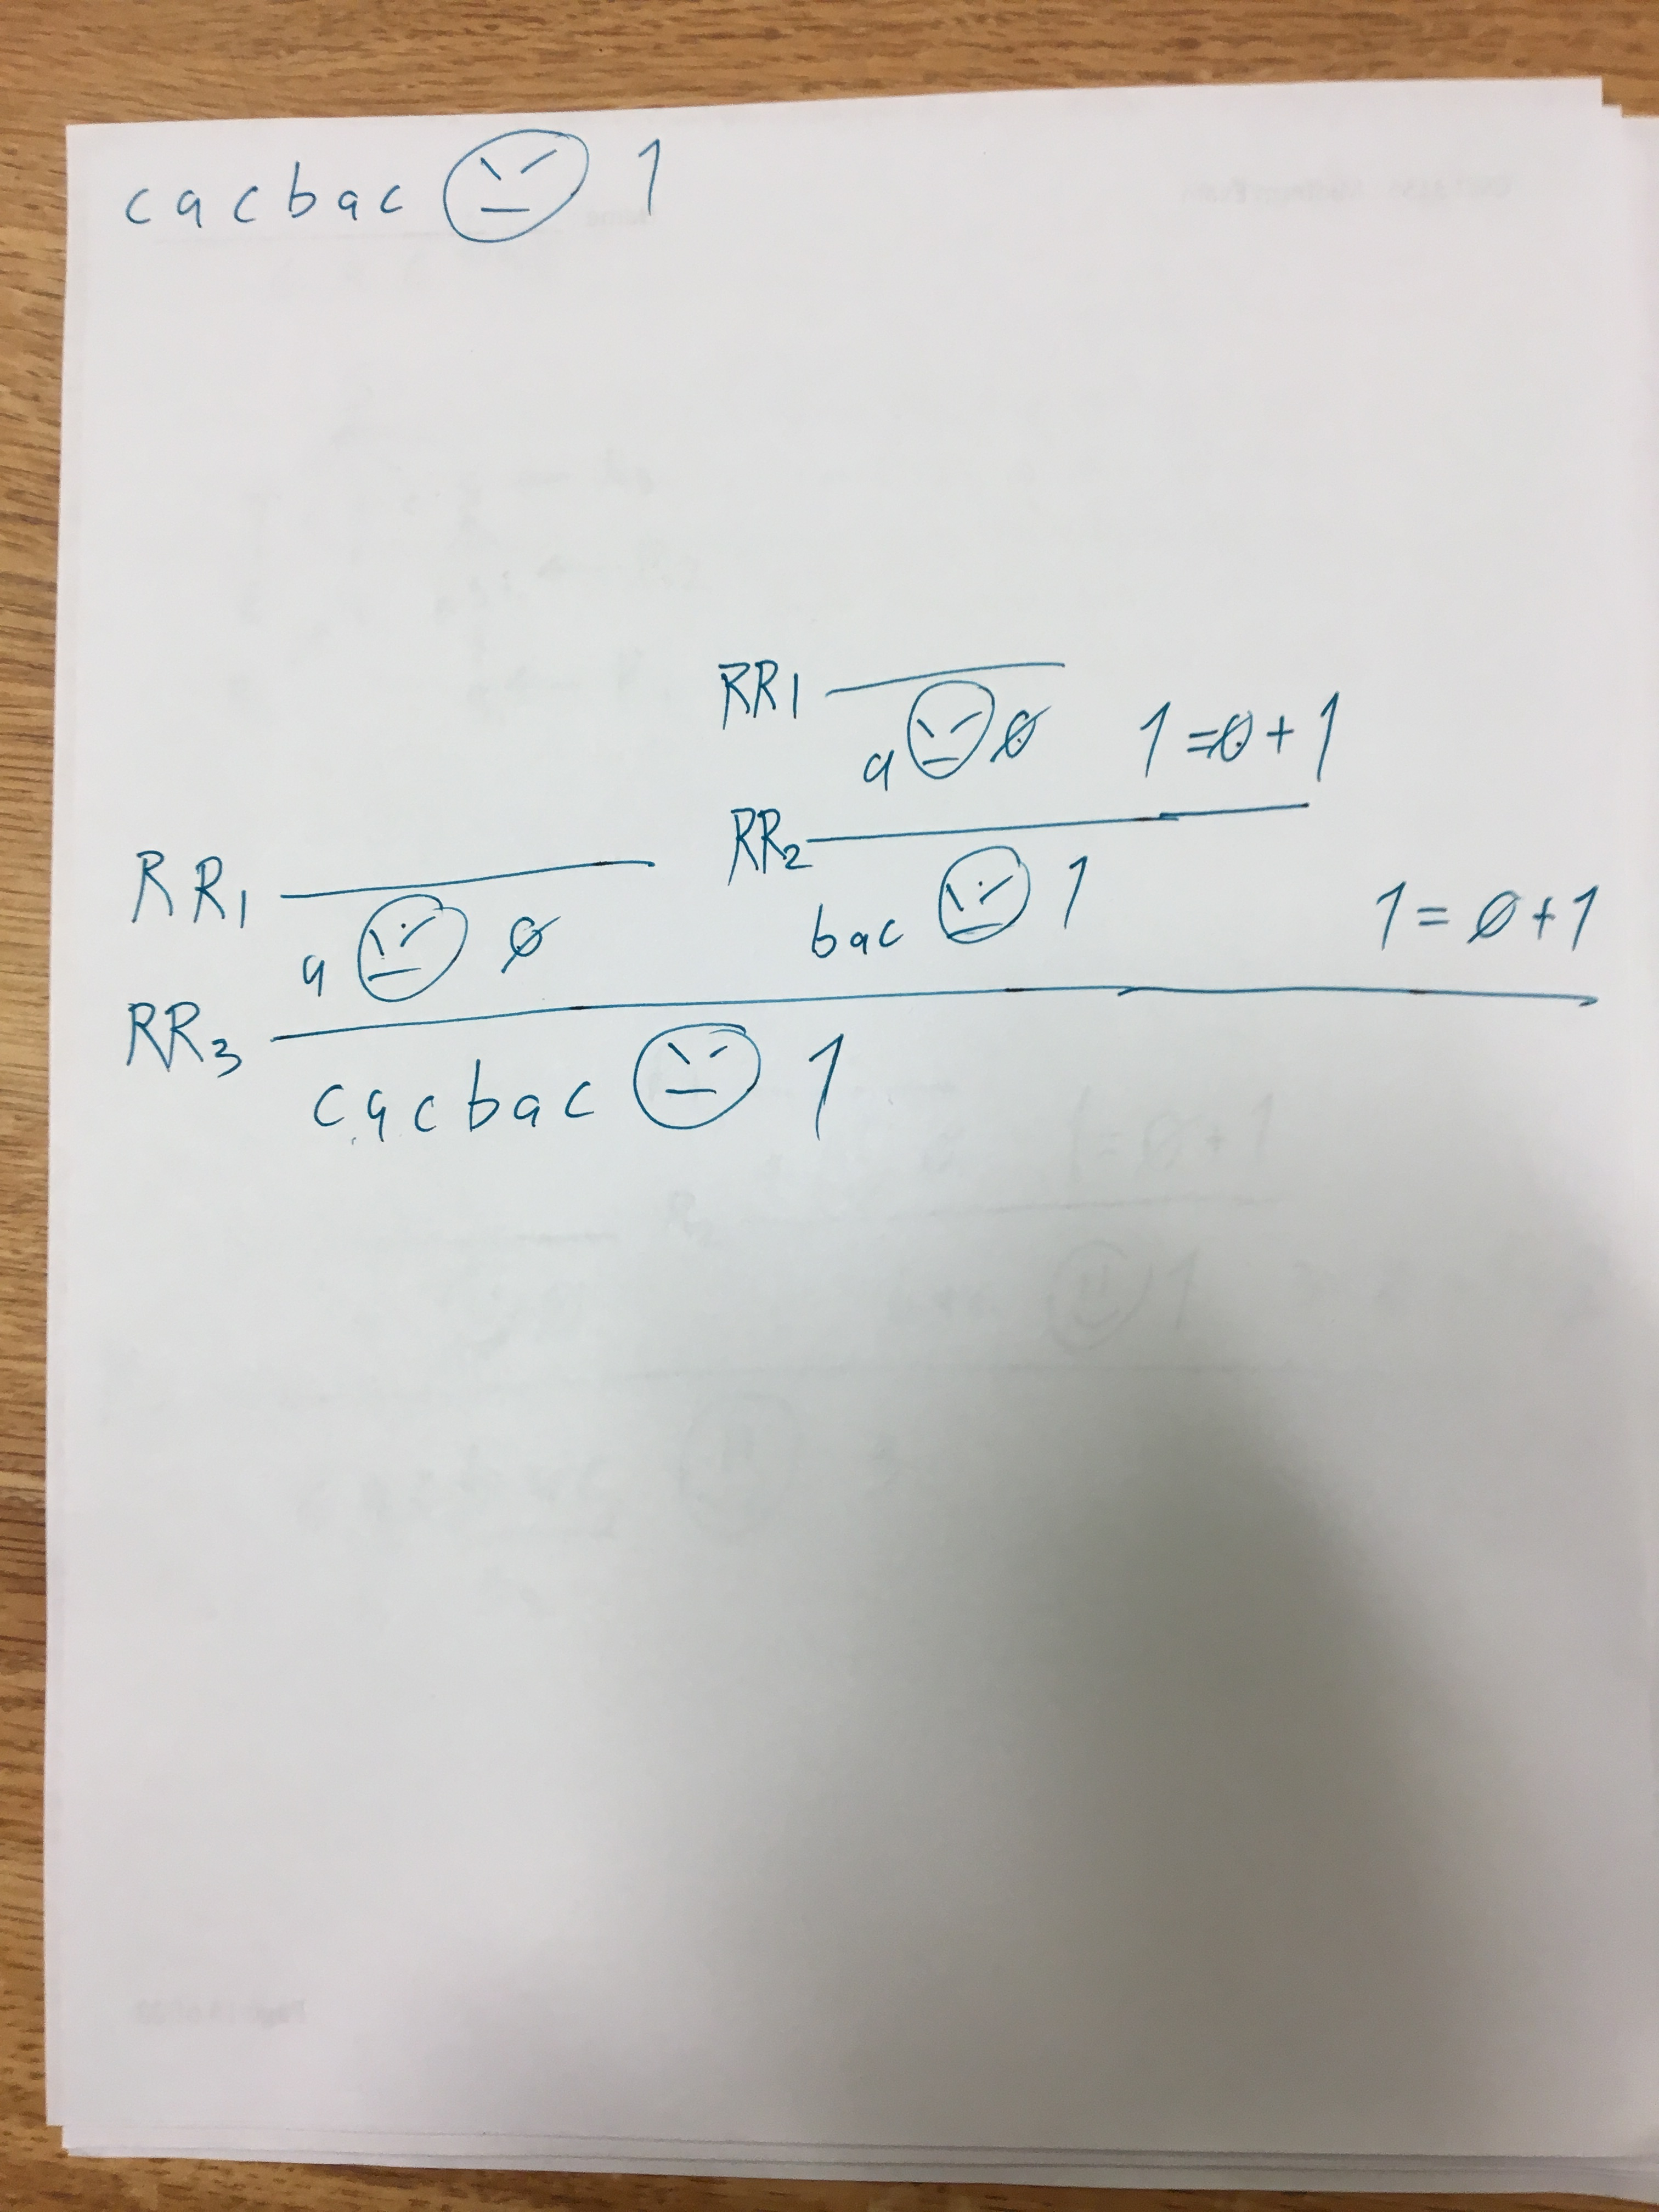
Derivation using this
New op.sem. And new
Rules but the same
Sentence from before

Slide 10
Ambiguity in a grammar
Using a totally different grammar

Slide 11
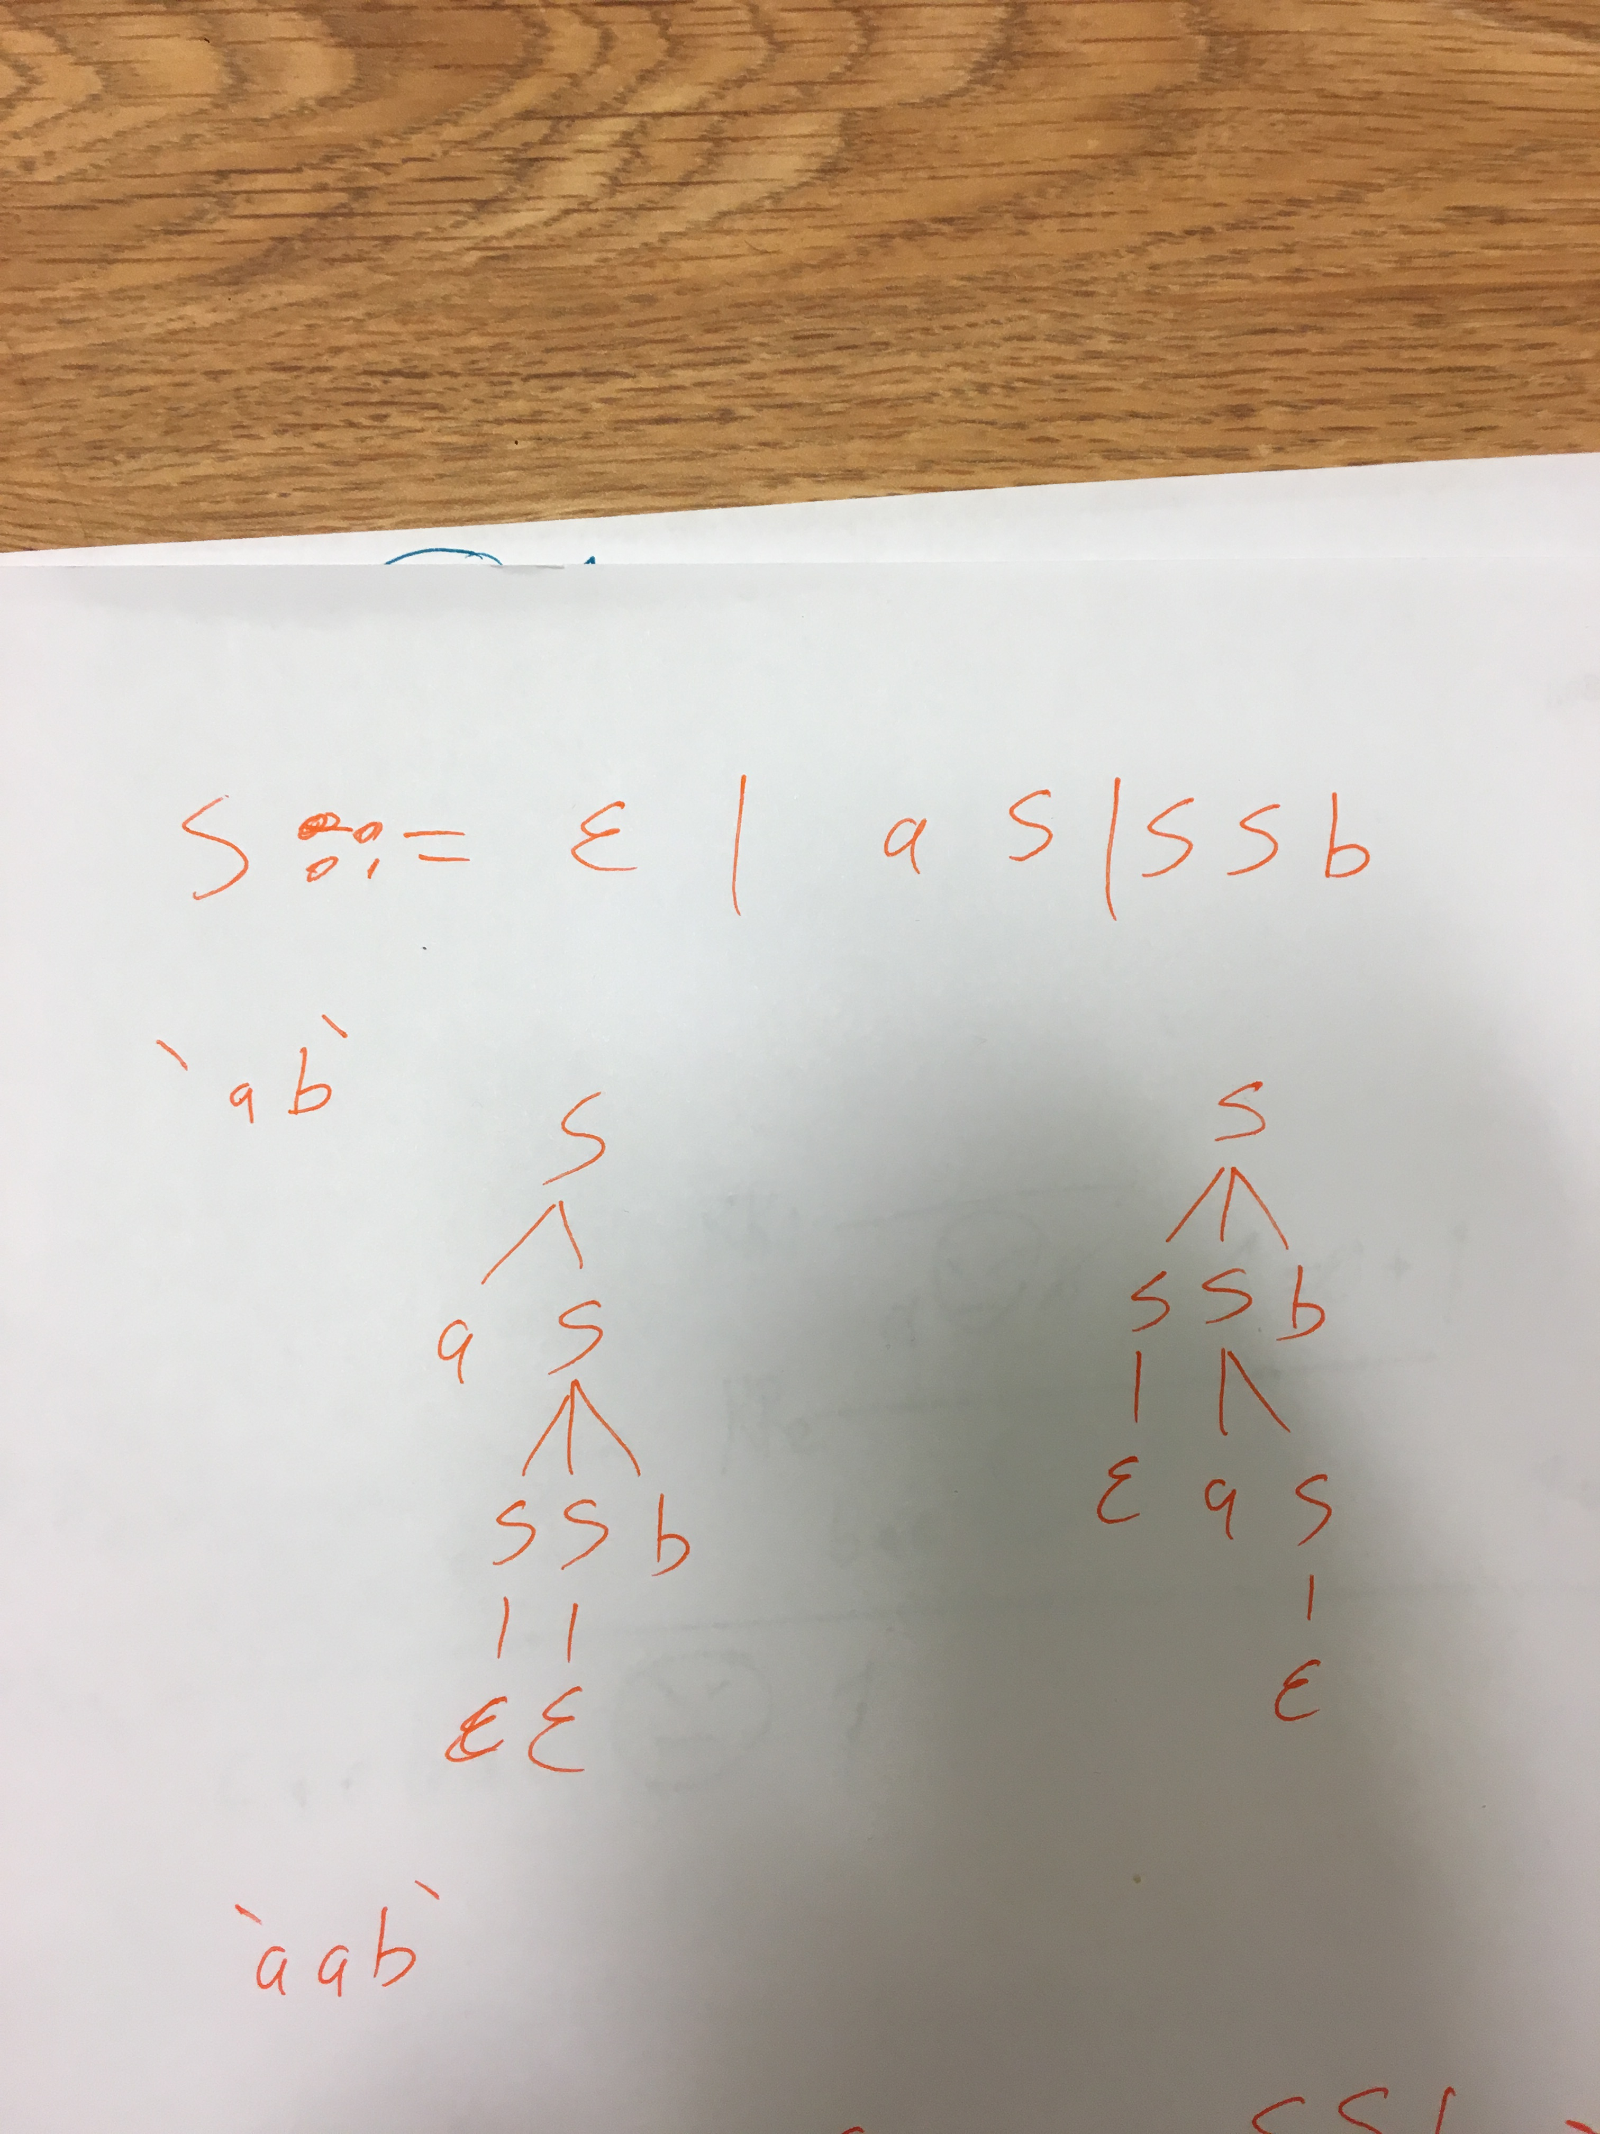
The sentence `ab`
Is ambiguously defined by
The grammar
There are 3 trees that I
Could write for the sentence
2 is enough to demonstrate
ambiguity

